Slide 1

Current Trends in AI Technologies: The 2025 Landscape
Explore the dynamic shifts and emerging frontiers defining artificial intelligence in the coming year.

Slide 2
The AI Revolution Accelerates in 2025
Market Surges
Generative AI
Transformative Shift
AI market projected to surpass $800 billion by 2030, reflecting explosive growth and investment.
Adoption surges with 75% of business leaders now integrating it into their operations.
AI is moving beyond productivity tools to become decision-making agents, reshaping business landscapes.
The rapid evolution of AI is not just enhancing existing processes but fundamentally changing how industries operate.

Slide 3
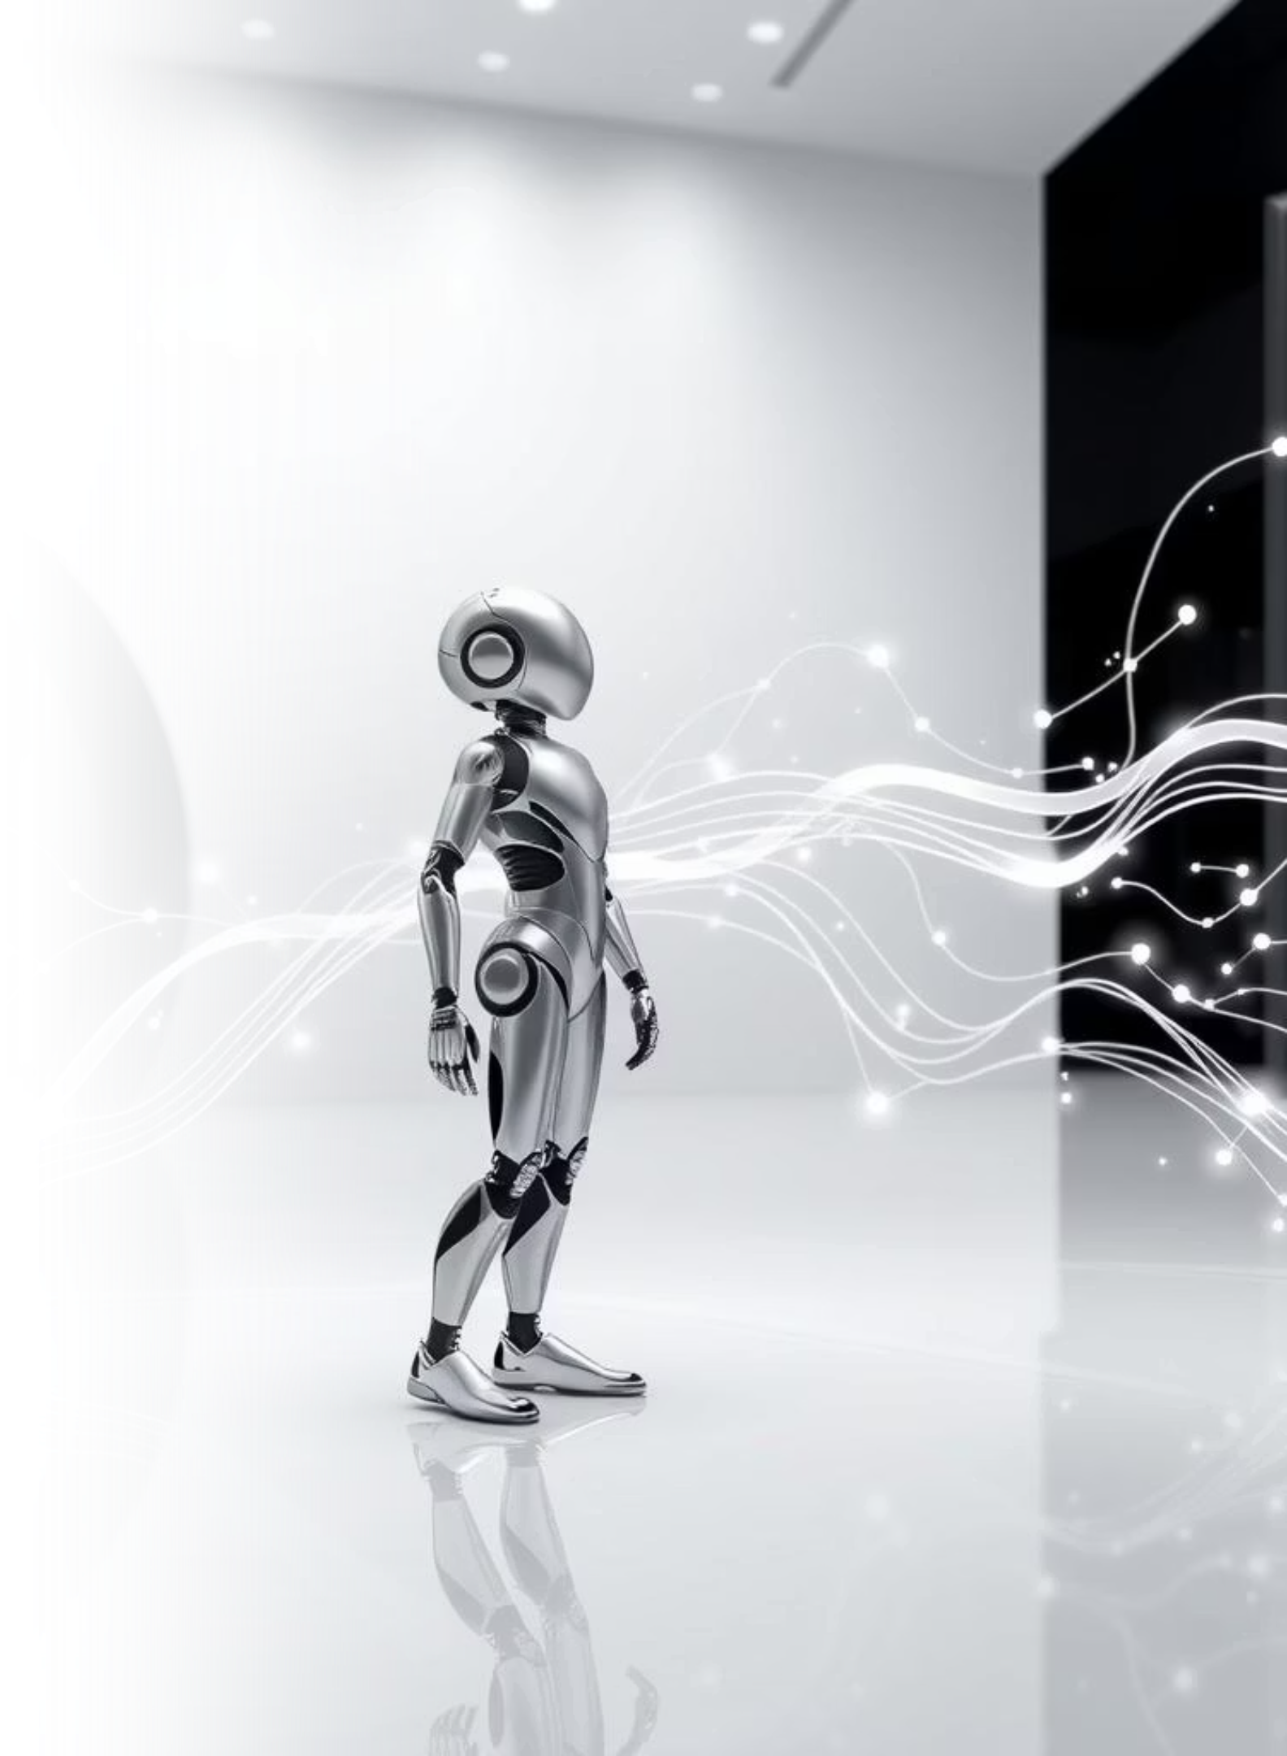
From Generative AI to Agentic AI: The Next Frontier
Rise of Agentic AI
2025 marks the emergence of Agentic AI: autonomous AI systems designed to achieve complex goals, moving beyond simple task assistance.
Empowering Autonomy
AI agents are evolving to handle intricate workflows and business processes with greater independence. For example, Microsoft 365 Copilot is now used by 70% of Fortune 500 employees for automating routine work, liberating human potential.
This pivotal shift empowers AI to adopt more proactive roles, significantly driving efficiency and fostering innovation across diverse organizations.

Slide 4
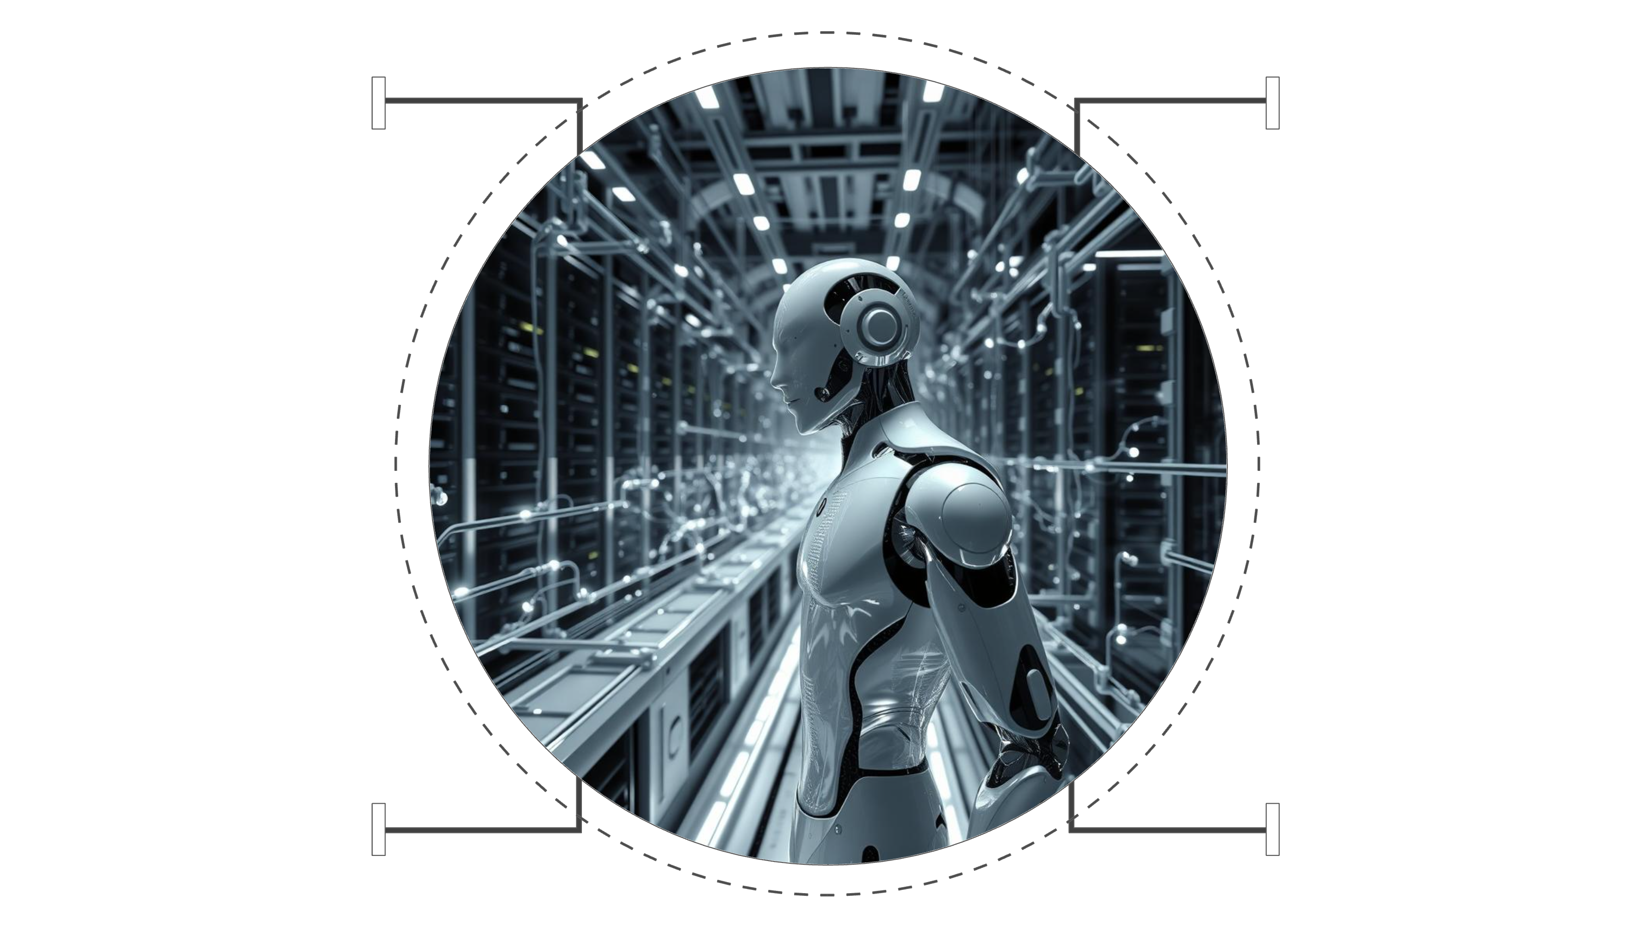
AI Reasoning Powers Smarter Models
Law
Medicine
Compare contracts and detect inconsistencies
Reason through diagnoses and treatment plans
Coding
Science
Generate and verify multi-step code workflows
Design experiments and interpret results
Advanced AI reasoning mimics human logical thinking, enabling sophisticated problem-solving in critical fields.
Google's new reasoning model boasts breakthroughs in logic and task-solving capabilities.
Applications span law, medicine, coding, and science, allowing AI to compare contracts, generate code, and execute multistep workflows with precision.

Slide 5

Custom Silicon & Edge AI: Fueling Performance and Efficiency
The demand for AI-specific chips (ASICs) is soaring. These specialized processors are custom-designed for particular AI workloads, delivering superior performance, significantly lower power consumption, and greater efficiency compared to general-purpose GPUs.
This shift from versatile GPUs to purpose-built ASICs optimizes everything from complex training models in data centers to real-time inference on client devices.
Alongside this, Edge AI adoption is accelerating rapidly, pushing powerful AI capabilities directly onto small, local devices. This decentralization significantly reduces reliance on centralized cloud data centers, offering benefits such as reduced latency, enhanced data privacy, and lower bandwidth usage.
Typical applications range from smart cameras and industrial sensors to autonomous vehicles and advanced medical devices, where immediate decision-making is critical.
Industry leaders like Broadcom are at the forefront of this innovation, developing power-efficient AI networking chips specifically engineered to handle the massive data flows and intense computational demands of advanced AI systems. This specialization is crucial for meeting the escalating computational demands of modern AI, ensuring that models can run faster and more efficiently than ever before.
Beyond network chips, many tech giants are now designing their own custom AI accelerators, such as Google's TPUs and Apple's Neural Engine. This trend underscores a strategic move towards hardware-software co-design, further blurring the lines between traditional computing and AI-driven processing, and setting the stage for a new era of ultra-efficient, high-performance AI.

Slide 6



Multimodal AI: Beyond Text to Images, Audio, and Video
Image Understanding
Voice Interaction
Video Analysis
AI tools now comprehend and generate visuals, from complex images to creative art.
AI models engage in natural voice conversations, making interfaces more intuitive.
AI can analyze and interpret video content, extracting valuable insights and creating new content.
This integration across multiple data types creates hyper-personalized user experiences, making AI more accessible and intuitive.

Slide 7
Enterprise AI: Integration and ROI Challenges
Deployment vs. Impact
74% of enterprises use generative AI, but only ~15% use it for critical decision-making.
Efficacy & Explainability
Measuring AI's effectiveness and understanding its decisions are crucial for broader adoption and trust.
Development & Deployment
Partnerships like Databricks + Anthropic streamline enterprise AI development and integration.
Overcoming these hurdles is vital for enterprises to fully realize the transformative potential of AI and achieve significant ROI.

Slide 8
AI and National Security: The Race for Artificial General Intelligence (AGI)
"AGI is not just a technological marvel; it's a strategic resource that will redefine global power dynamics."
Artificial General Intelligence (AGI) is increasingly viewed as a national security priority, driving a global race for development.
While some predict AGI's arrival as early as 2025, others foresee a more distant future.
This "AI arms race" fuels innovation but also raises profound ethical and geopolitical questions that demand careful consideration.

Slide 9



Emerging AI-Driven Technologies to Watch
Quantum Computing
Accelerating AI capabilities in cryptography and drug discovery with unprecedented processing power.
AI-Powered Robotics
Advancing with greater autonomy and expanded deployment across various industries.
5G Expansion
Enabling real-time AI applications in IoT and autonomous vehicles, enhancing connectivity and responsiveness.
These technologies represent the next wave of innovation, promising to unlock new possibilities and further integrate AI into daily life.

Slide 10

The Future is Now: Embracing AI’s Transformative Power
AI is no longer just a tool; it's a partner in innovation, creativity, and decision-making, reshaping industries at an unprecedented pace.
Businesses must adapt to AI's rapid evolution or risk falling behind in an increasingly competitive landscape.
The 2025 AI era promises smarter, faster, and more autonomous systems that will profoundly impact every industry and aspect of life, demanding strategic engagement and visionary leadership.

